Slide 1


GCS AND LIMB Assessment
PE
NICU

Slide 2
Learning Objectives
Purpose of a neurological assessment
Definition and indications of carrying out a GCS assessment
Causes of altered consciousness
How to carry out a GCS, pupil and limb assessment

Slide 3
Purpose of Neurological Assessment
Determine whether the patient has a neurological problem
Establish a baseline assessment
Determine any changes in condition (improving, the same or deteriorating)
Detect life-threatening situations which need medical intervention

Slide 4
Neurological Assessment
Level of Consciousness
Pupillary Reaction
Vital Signs
Motor Function
Sensory Function
Cranial Nerve Dysfunction
Leads to: Identification, prevention and treatment of secondary “cerebral” insults that will worsen outcome.
Notes:
All these are part of an assessment, however the sensory function and cranial nerve check is mostly done by doctors/CNS

Slide 5
Consciousness
Arousal and wakefulness involves the reticular activating system in the brain stem.
Consciousness is the most sensitive indicator of neurological change.
For the purpose of the GCS, consciousness is defined as the brain’s ability to engage with its immediate surroundings.

Slide 6
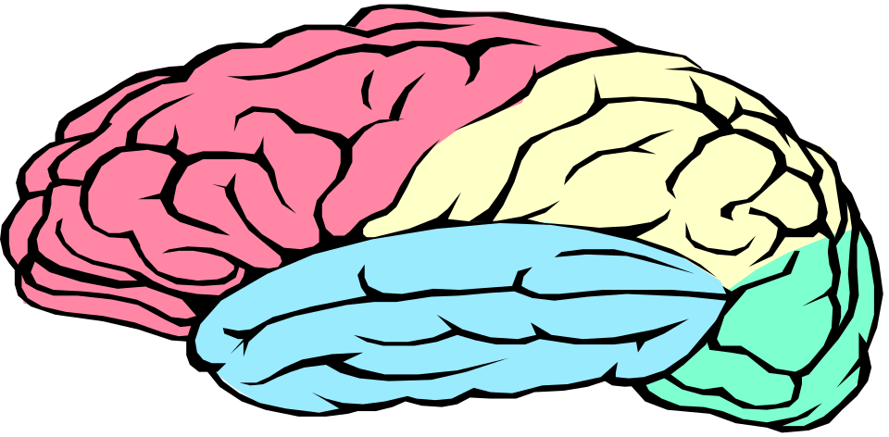
The Glasgow Coma Scale
Teasdale & Jennett (1974)
Aims to provide a quick and reliable tool for the assessment of consciousness in the acute patient who has sustained cerebral insult.
The GCS was developed to standardise descriptions of coma which mean different things to different people e.g. drowsy, stupor, semi-conscious.

Slide 7
Consciousness
Neurological change can occur rapidly or slowly, over hours, days or weeks.
Two aspects of consciousness are measured;
Arousal – awareness of the environment (ARAS).
Cognition – demonstrates an understanding of what the observer has said by responding to a task.
Notes:
ARAS ascending reticular activating system:
A network of neurones in the brain, including portions of the brainstem; stimuli from multi sensory pathways are channelled through the area causing a person to sleep and wake up again. (very simplified)
Ask them what intra/extra cranial causes they can think of

Slide 8
Intra-cranial causes of altered consciousness
Destruction of brain tissue or structures by disease or insult e.g. head injury.
Space occupying lesions: tumours, abscesses.
Haemorrhagic events: SAH, EDH, SDH, cerebrovascular accident.
Infections: encephalitis, meningitis.
Degenerative conditions: Alzheimers, MS.
Secondary insults: cerebral oedema, raised ICP, ischaemia, infarction, increases in cerebrospinal fluid (hydrocephalus).
Notes:
2 types of causes for altered consciousness: intra and extra cranial causes

Slide 9
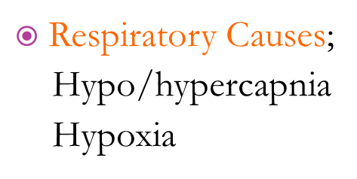
Extra-cranial causes of altered consciousness
Most common causes:
Hypoxia
Hypo/hyperglycaemia
Sedative Drug overdose
  anaesthetics, opiates, anticonvulsants, antidepressants, recreational drugs and alcohol
Metabolic causes:
Electrolyte imbalance
Acid base imbalance

Slide 10
Extra-cranial causes of altered consciousness
Cardiovascular instability;
Sepsis, shock and trauma
Liver (hepatic coma)
Renal (uremic coma)
Endocrine dysfunction (thyroid, parathyroid, adrenals)
Notes:
When would you use GCS?
Maximum and minimum score?
If in doubt, score low

Slide 11
When to use the GCS
Always following a head injury.
Following a fall and you suspect they may have hit their head.
Patients admitted with subarachnoid haemorrhage, brain tumour, stroke, seizures, encephalitis, hydrocephalus.
If your patient becomes drowsy.
If your patient becomes confused.
Notes:
How do you score GCS? Highest/lowest possible?

Slide 12
Method
Standard stimuli will produce standard responses that can be graded to provide a measure of the level of consciousness.
The Scale scores patient responses in three areas:
  Eye opening E1 - E4 - 4 points
  Verbal response V1 – V5 – 5 points
  Motor response M1 - M6 - 6 points

Slide 13
Scores are added together to give an overall assessment of the patient’s neurological status
Best score is E4 V5 M6 = GCS 15 – a patient who is awake, alert and fully responsive.
Worst score is E1 V1 M1 = GCS 3 – no cerebrally mediated response to stimulus.

Slide 14
The GCS: getting it right
Score only what you can prove.
Don’t make allowances for sleepiness, alcohol or drugs.
If in doubt, score low.
Notes:
Show video if possible!!

Slide 15
GCS VIDEO
GCS QUIZ (5mins)

Slide 16
Eye Opening Response
Eye opening is linked to being awake and alert and is controlled by neurones located in the brain stem, hypothalamus and thalamus (the ascending reticular activating system).
Damage to the Oculomotor nerve (third) responsible for eye opening, may make it physically impossible to open eyes.

Slide 17
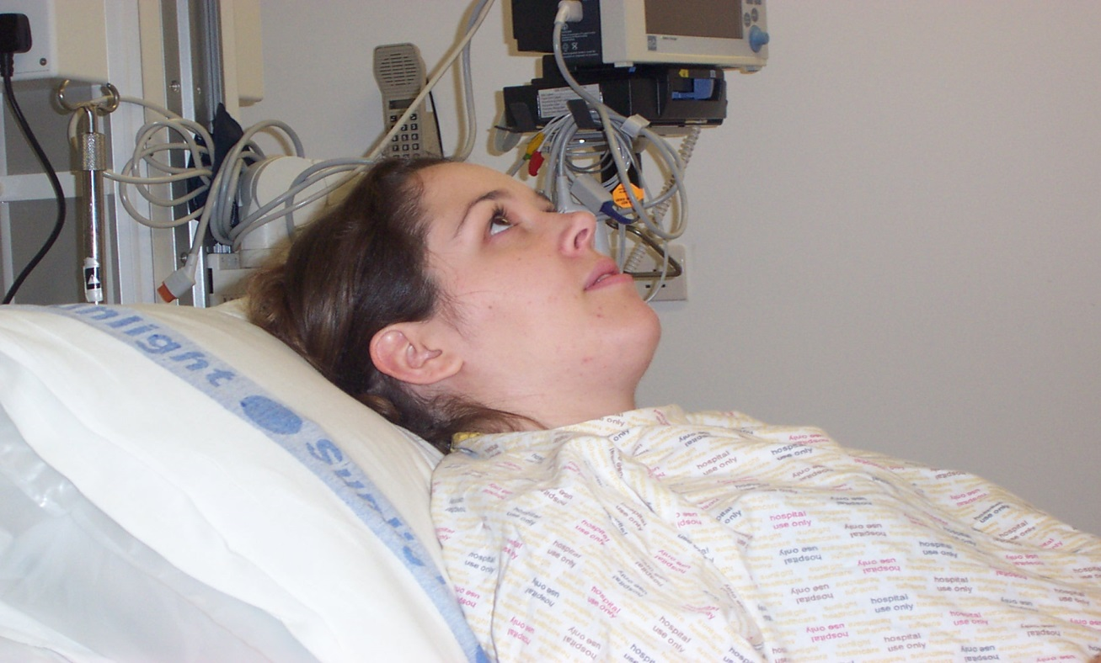
E4 - Eyes open spontaneously
The eyes are open before the exam starts

Slide 18
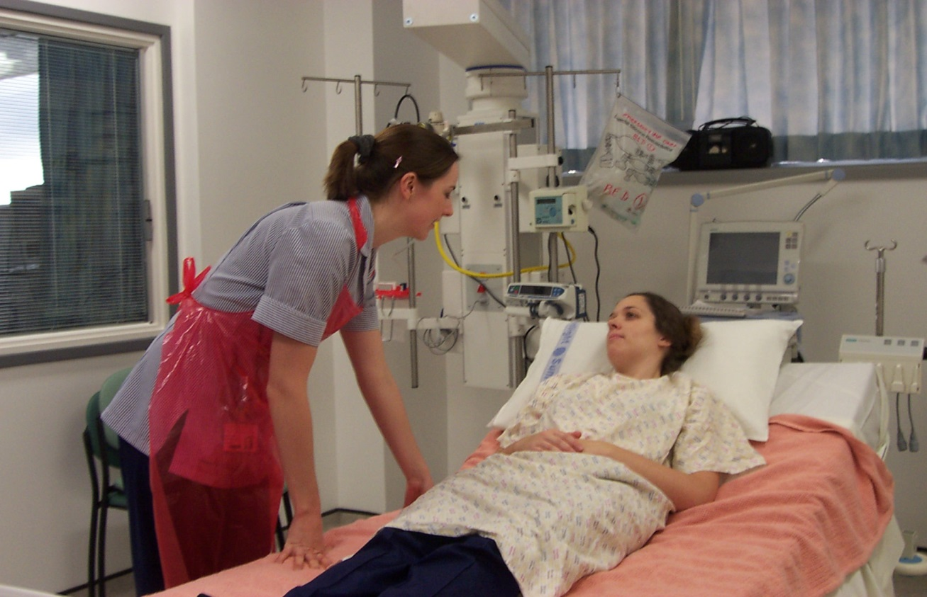
E3 - Eyes open to speech
The eyes open to speaking or shouting

Slide 19
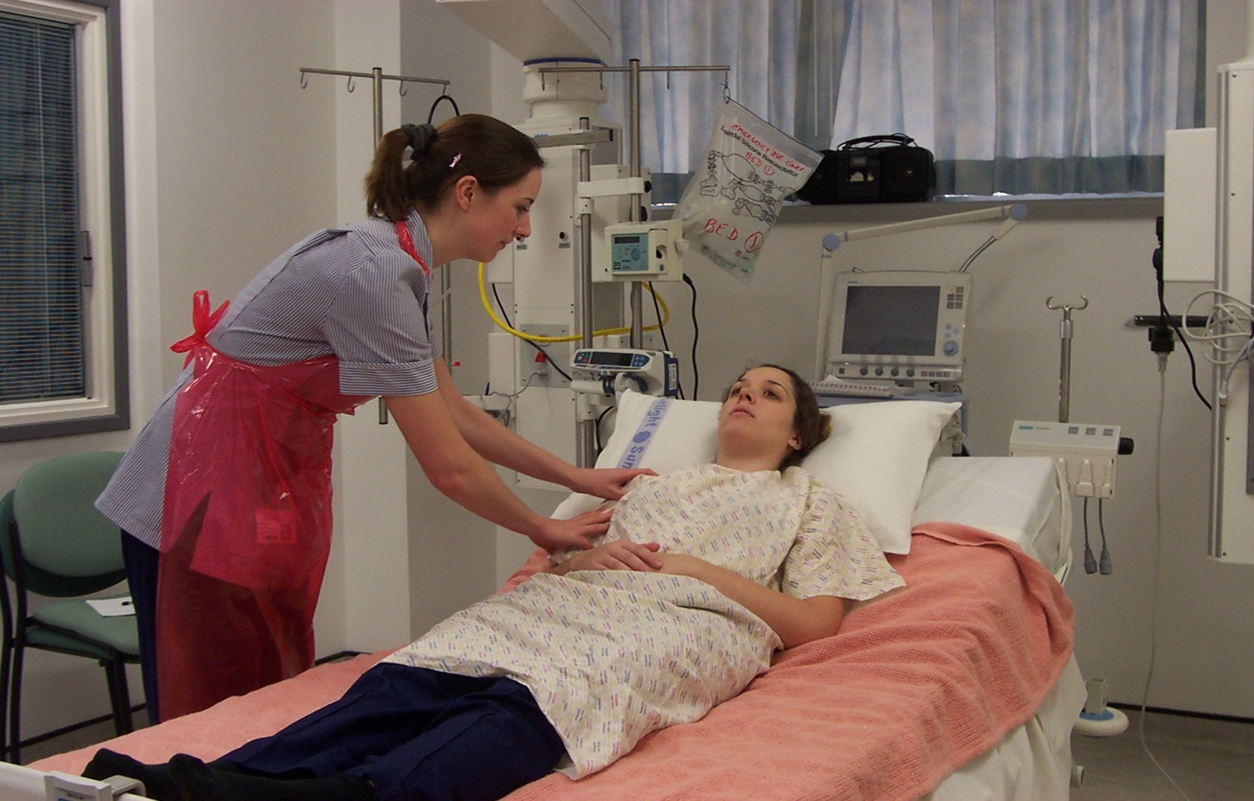
E2 - Eyes open to pain
Eyes open on physical contact with the patient

Slide 20
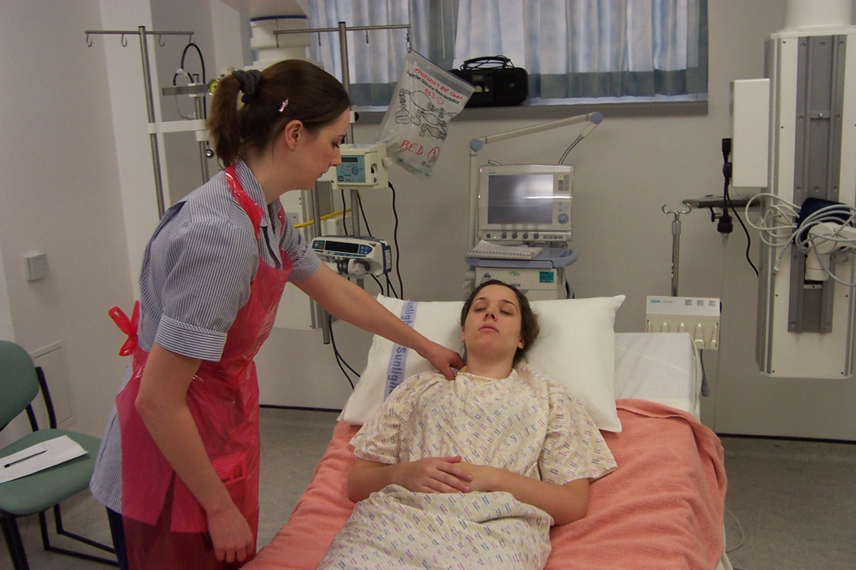
E1: non-eye-opening
The eyes do not open at all

Slide 21
Verbal Response
The verbal response assesses two aspects of cerebral function:
Comprehension or understanding of what has been said – reception of speech.
Ability to express thoughts into words – expression of speech.
Damage to the speech centres may mean the patient is alert but cannot speak - aphasic a score of 1 would be given.
Dysphasia can be receptive or expressive

Slide 22
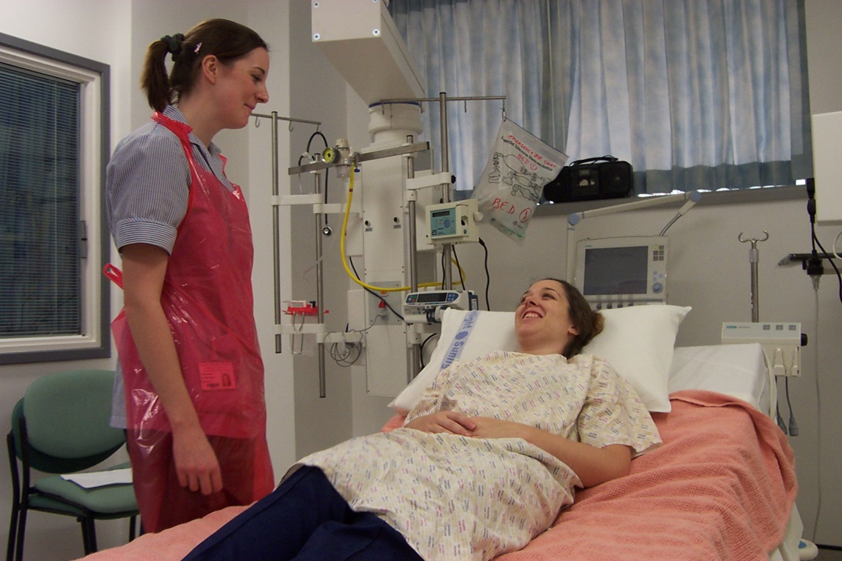
V5 - Orientated
Patient tells you her name, the day and date and the name of the hospital. Nothing more, nothing less.

Slide 23

V4 - sentences
Speaks in sentences but not orientated; sentences may be brief (“F… off!” is a sentence)

Slide 24
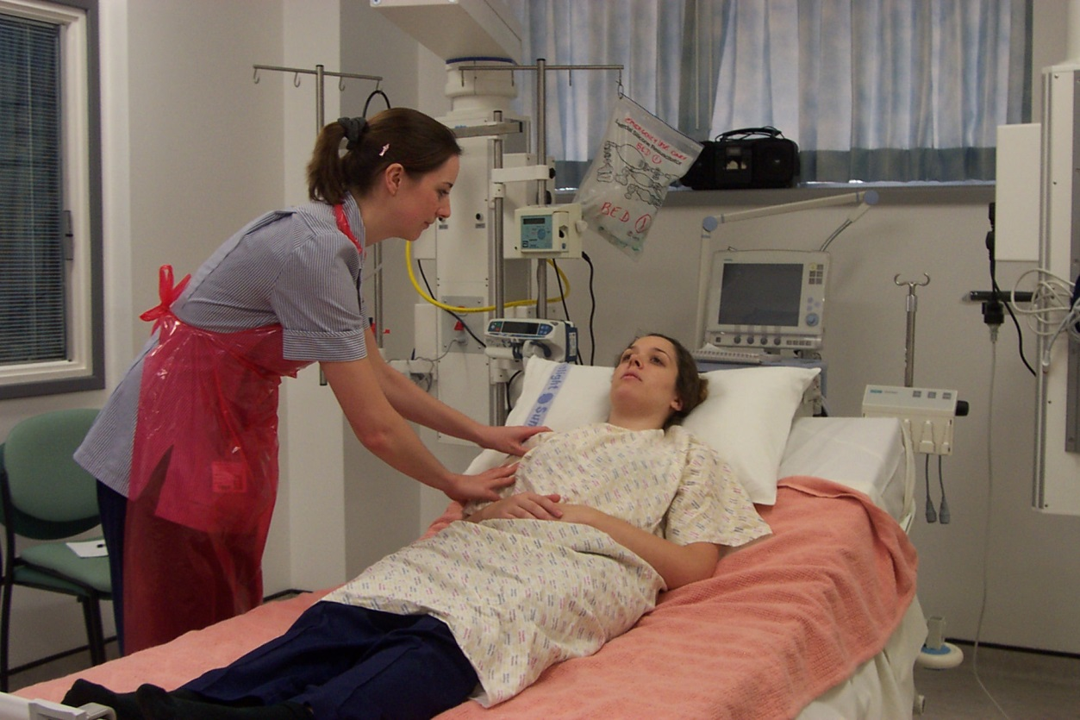
V3 - Words
Formed words are audible, but are random or meaningless in the context

Slide 25
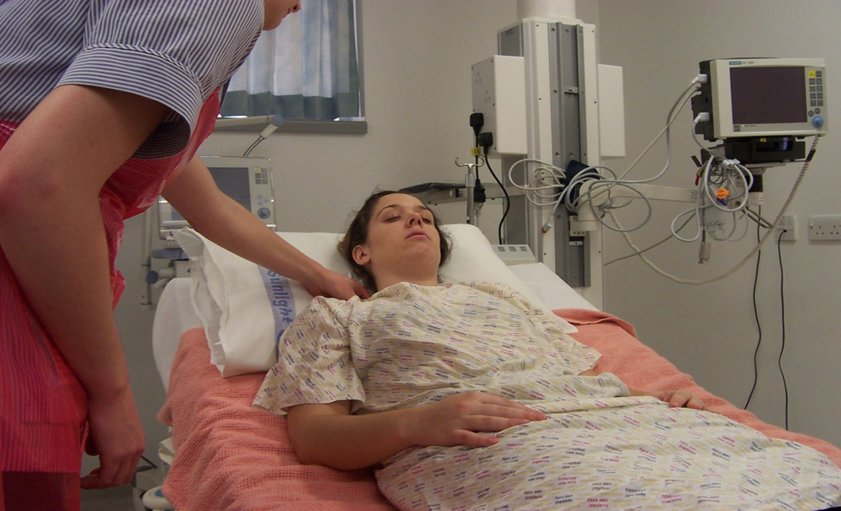
V2 - sounds
Patient makes a noise (usually on painful stimulus) but no words are distinguishable (snoring does not count)

Slide 26

V1 - no verbal response
No response even on painful stimulus

Slide 27
Motor Response
We are concerned with the brain’s function and not the strength of the limb.
If left and right sides respond differently, record only the better response e.g. if the right arm localises and the left arm abnormally flexes record the right arm
Begin by asking for a simple command
  “stick out your tongue”
  “give me a thumbs up”
Notes:
In terms of GCS we don’t need to assess strength yet, this si about comprehension and having an ordered thought process

Slide 28
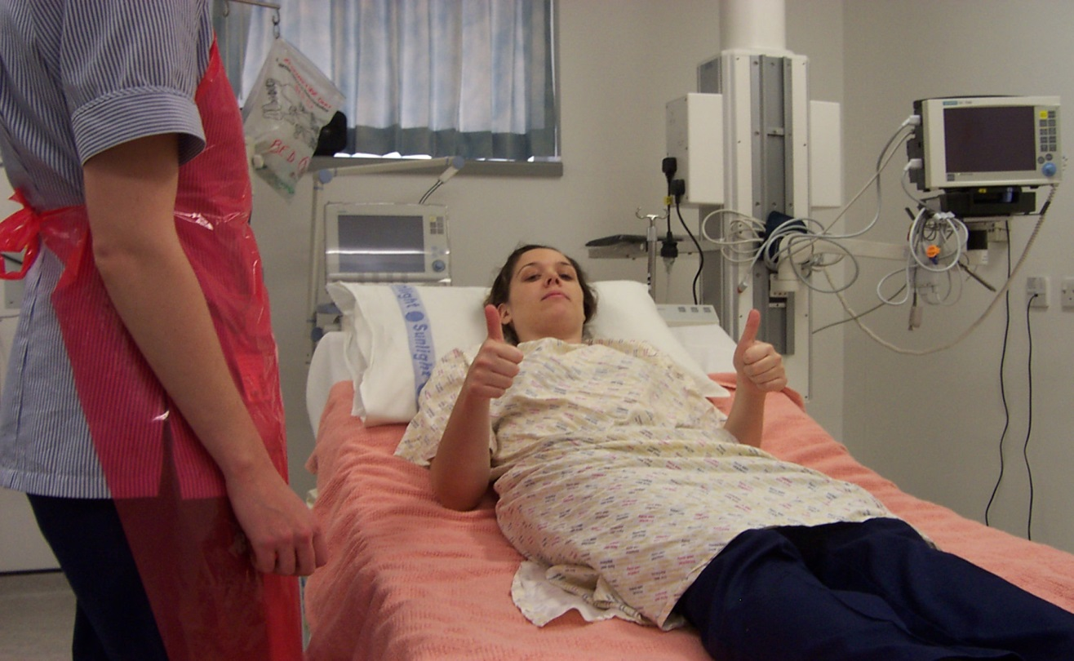
M6 - obeys commands
Patient follows simple commands. Beware the hand-clasp reflex
Notes:
Squeezing hands is not an adequate response – we have a grasp reflex which could be activated by touching a patients’ palm – false “positive” response

Slide 29
Motor Response
If patient does not obey commands move onto applying a painful stimulus.
Painful stimulus in relation to the GCS assessment needs to be applied in the distribution of the cranial nerves.
  Sternal rub: does not adequately distinguish localising and flexing. Produces very visible bruising. Not recommended.
  Nail bed pressure: not for GCS assessment. Can produce peripheral, spinally mediated, response

Slide 30
Supra-orbital ridge pressure
Looks vicious but very effective
Contra-indicated with skull fractures
Tends to make patients screw their eyes shut, so only effective for Motor Response

Slide 31
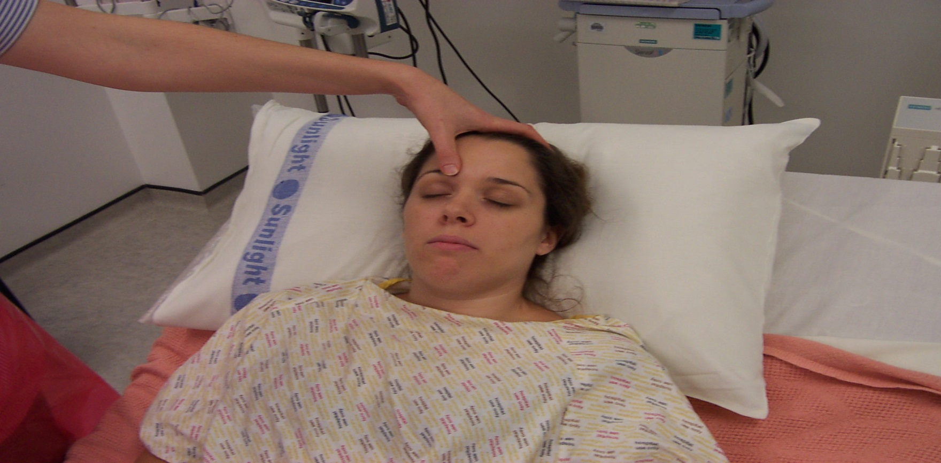
Supra-orbital ridge pressure

Slide 32
Trapezius pinch
Minimal bruising
Safe
Ideal for repeated observation
Avoid if clavicle fractured - try the other side of the neck

Slide 33
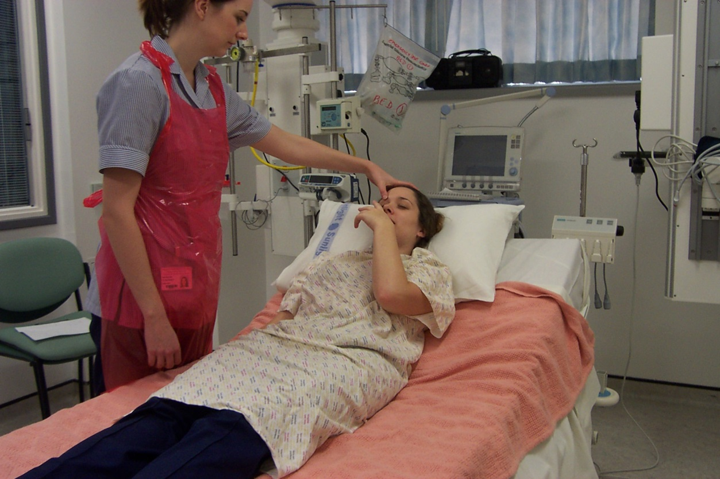
Motor Response: M5 - localising
Supra-orbital ridge pressure - patient gets a hand above the chin

Slide 34
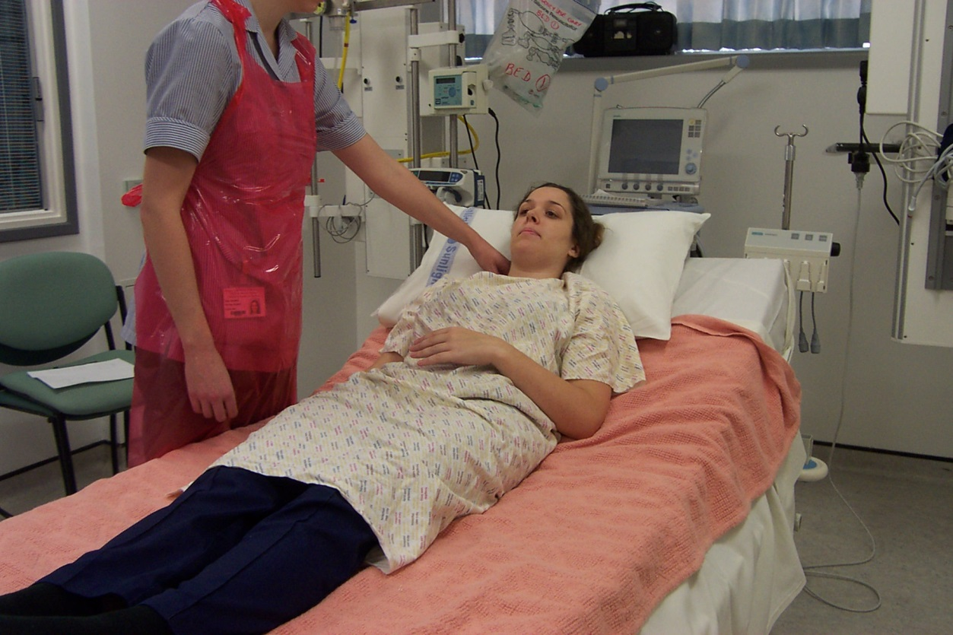
M4 - normal flexion
A normal patterned movement, but not purposeful enough to be localising

Slide 35
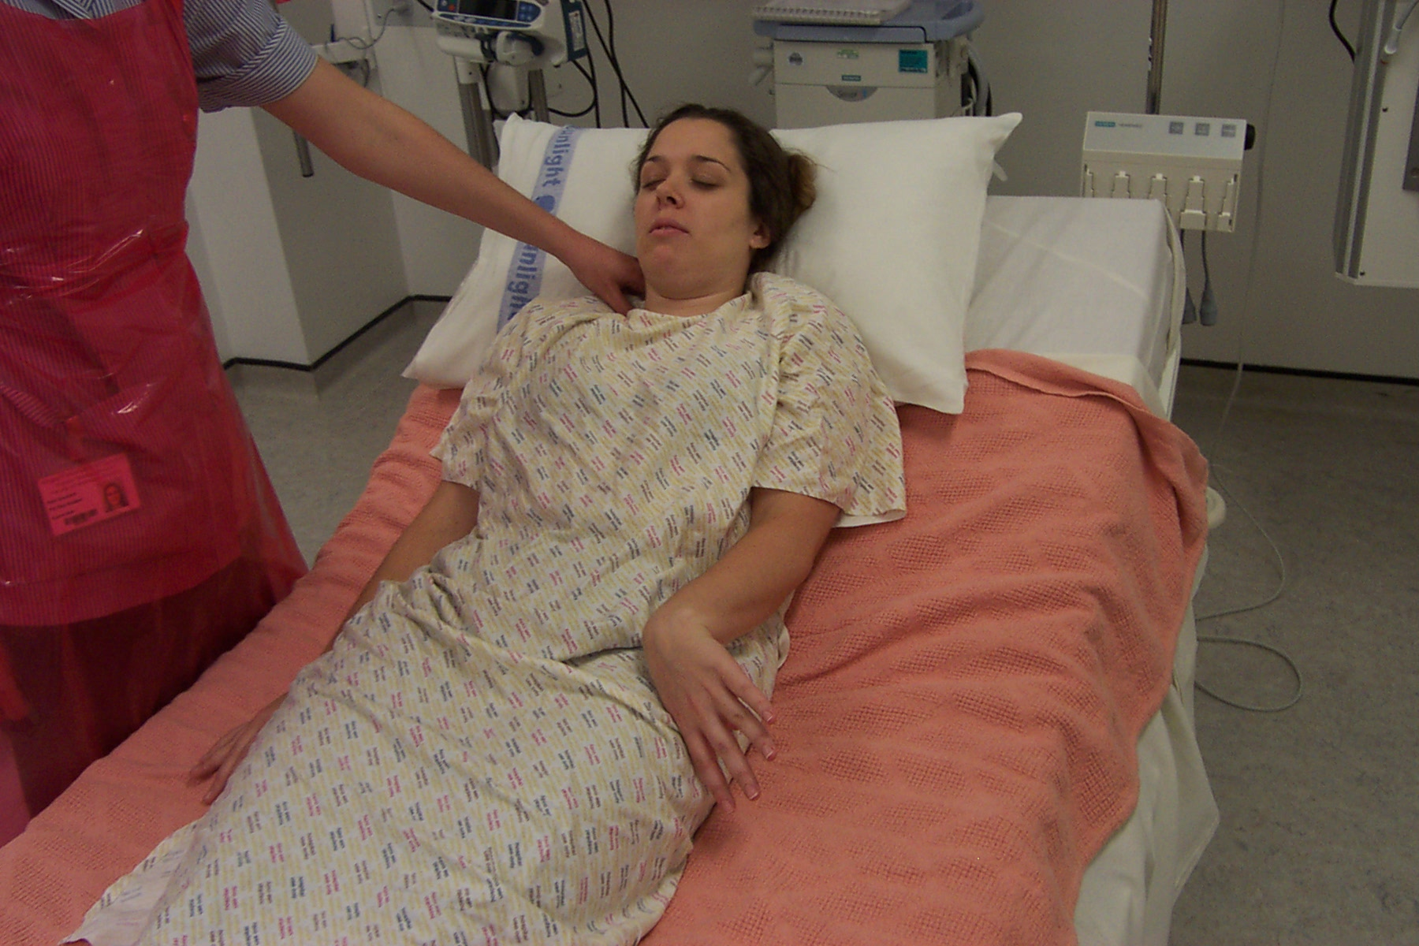
M3 - abnormal flexion
The elbow flexes, but the movement pattern is abnormal

Slide 36
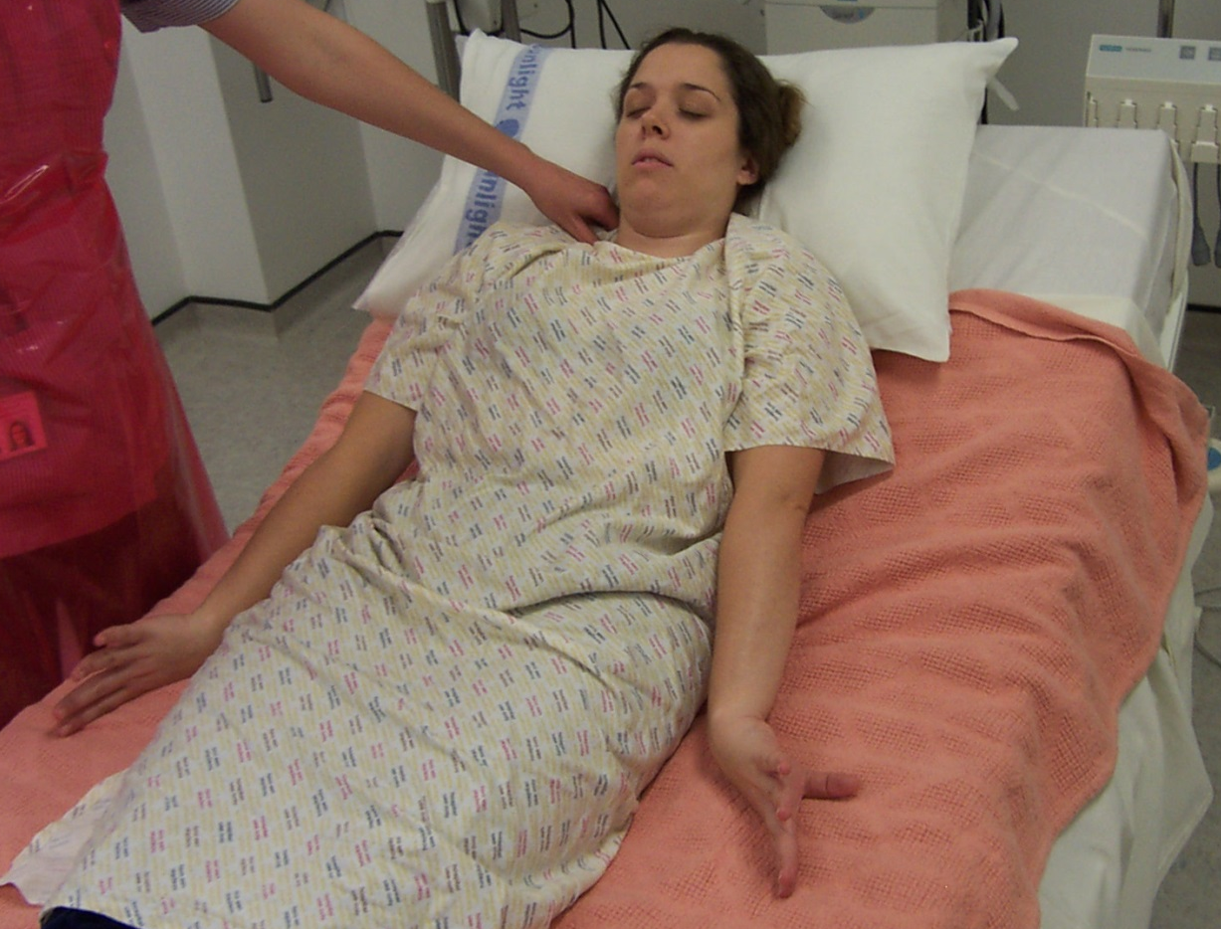
M2 - extension
The elbow straightens

Slide 37
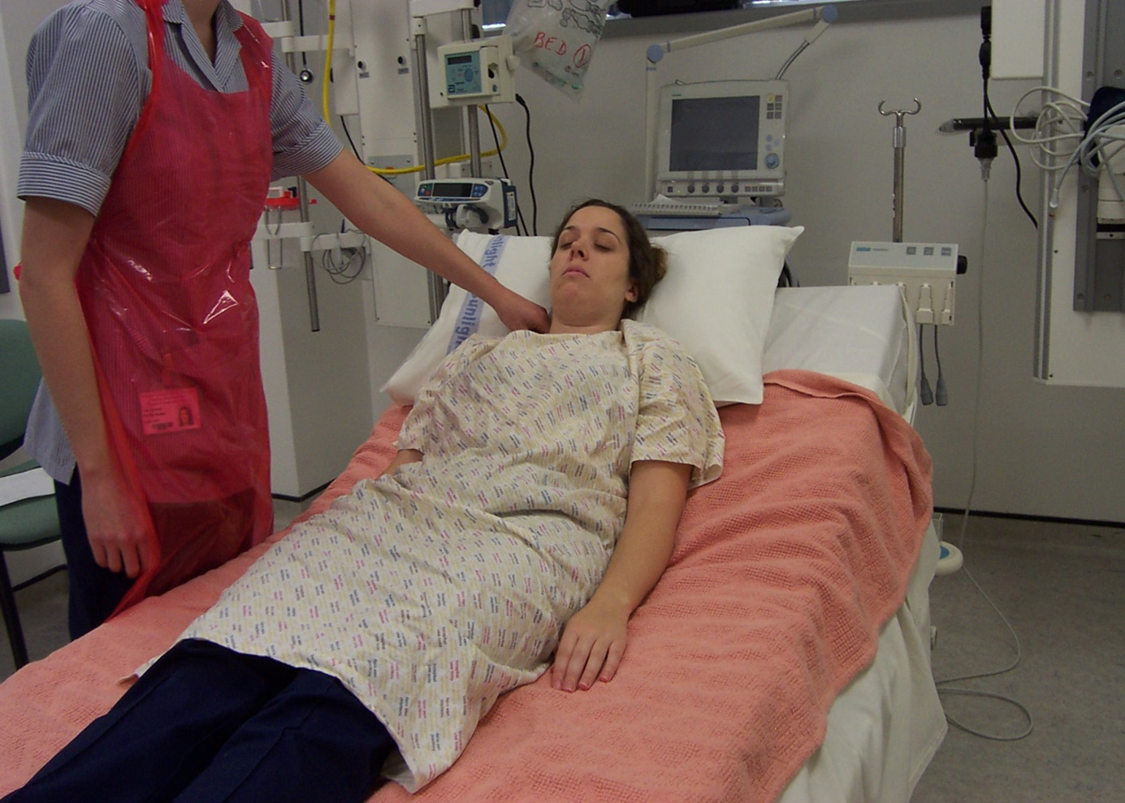
M1 - no motor response

Slide 38
Reporting the score
When reporting the GCS, give it in full
  GCS = E4 V5 M6 = 15
  GCS = E2 V2 M4 = 8
  GCS = E1 V1 M1 = 3
Notes:
What would you do if a score has changed?

Slide 39
Deteriorating Scores
What to do if the score has changed?
Get someone else to check if you do not feel confident with your assessment
Report it – even if it is only 1 point it is significant
Increase level of observations repeat in half an hour
In Neuro ICU may need to reduce sedation

Slide 40
Pupil observations
Ideally in a darkened room
Observe both pupils together - without a torch – for;
  size
  symmetry
  regularity of shape

Slide 41
Pupil observations
Use a pen-torch
Start at the corner of one eye and move the light across the pupil and look to see if it constricts
Repeat the process with the other eye, again looking for movement in the pupil
The reaction may be brisk or sluggish
A fixed (non-reacting) and dilated pupil is a late sign of high intracranial pressure

Slide 42
PUPIL VIDEO
Pupil Video (3mins)

Slide 43
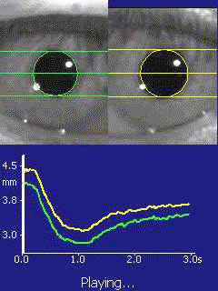
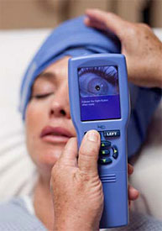
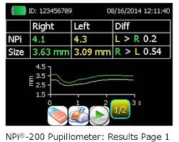
Pupilometer

Slide 44
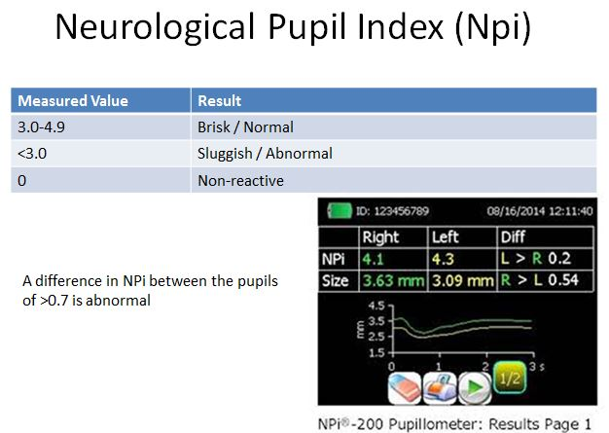

Slide 45
Frequency of GCS?
Depends on acuteness of injury or illness
Initially when the aim is to detect deterioration may be half hourly to hourly
If observations are stable then they may be reduced with guidance from medical team
Document in care plan if reduction or increase in frequency and rationale for change.

Slide 46
Vital Signs
If a patient needs neuro observations, they need vital signs observations as well.
Respiratory rate and pattern are critical – observe and count.
HR and BP change as ICP rises, but this only becomes clear when the ICP is dangerously high (Cushing’s triad).

Slide 47
Limb Observations
Distinct from the Motor Response part of the GCS
Looking for left-right differences that will indicate lateralized damage (e.g. in stroke)
If the patient obeys or localizes, can be easily assessed

Slide 48
Limb observations
Normal power – can resist your strength
Mildly weak – resistance easily overcome
Severely weak – can move the limb, but not lift it off the bed
Flexion – pulls limb away from painful stimulus
Extension – pushes limb towards stimulus

Slide 49
LIMB ASSESSMENT VIDEO
Limb Assessment (3mins)
Notes:
Stop video at 2:08

Slide 50
References
Waterhouse, C. (2007) An investigation into the use of the Glasgow Coma Scale in one case using root cause analysis, British Journal of Neuroscience Nursing, Vol 3 No.4 p169 – 174.
Hickey, J.V. (2019) The Clinical Practice of Neurological and Neurosurgical Nursing, 7th Ed. Lippincott.

