Slide 1

Posterior Reversible Encephalopathy Syndrome
PRES
Neuro ICU

Slide 2
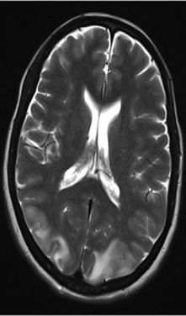
Aims and Objectives
Definition
Pathology
Causes
Symptoms
Management
Outcomes

Slide 3
Definition
Usually benign
poorly diagnosed condition associated with subacute to acute neurological
This affects the posterior occipital and parietal lobes
manifestations primarily affecting white matter
causing vasogenic oedema

Slide 4
Pathology
Vasoconstriction resulting in vasogenic and cytotoxic oedema
Endotheliel dysfunction
Disruption of the blood brain barrier
Notes:
The breakthrough theory hypothesizes that blood pressure increases beyond the threshold of autoregulation of cerebral blood flow and that the blood brain barrier (BBB) collapses to develop vasogenic oedema; whereas, the vasospasm theory hypothesizes that neurological symptoms develop because of cerebral ischemia associated with cerebral vasospasm. Thus, the two theories contradict each other.
If the breakthrough theory is the major cause, development of oedema should be remarkable for cases with marked blood pressure rise. However, PRES develops even in patients with normal blood pressure, and greater brain oedema is observed in patients with mild to moderate elevation of blood pressure than in patients with very high blood pressure.
Moreover, further evidence against this hypothesis is that approximately 30% of patients with PRES present normal or only slightly elevated blood pressure that does not necessarily exceed the normal upper autoregulatory limit, as would be expected in terms of cerebral hyperperfusion [12].
In the context of vasospasm and PRES, it has been debated whether spasms are merely a result of injury to the blood vessels or whether they are actively involved in the pathology. Blood pressure rises in most cases of PRES. Although the causes are unclear, it has been pointed out that vasospasm of the whole body may be involved in the blood pressure elevation. Additionally, cerebral vasospasm potentially triggers simultaneous cerebral ischemia. Under the ischemic condition, malfunction of the BBB and cerebrovascular autoregulation occur remarkably and rapidly. In particular, the collapse is striking when hypertension is induced following ischemia, and strong vasogenic oedema will occur.
Severe hypertension leads to failed autoregulation, subsequent hyperperfusion, and endothelial injury/vasogenic oedema and vasoconstriction and hypoperfusion lead to brain ischemia and subsequent vasogenic oedema.
The original hypothesis that severe hypertension leads to cerebral autoregulatory vasoconstriction, cerebral ischemia, and subsequent cytotoxic brain oedema has largely fallen out of favour because of the reversibility of the pathologic changes.
Moreover, 15%-20% of patients with PRES are normotensive or hypotensive. Even among hypertensive patients, less than half have a mean arterial pressure above the typical upper limit of cerebral blood flow autoregulation.
The current, more popular theory suggests that severe hypertension leads to cerebral autoregulatory failure and breakthrough vasodilatation with interstitial extravasation of fluid and subsequent vasogenic brain oedema and petechial hemorrhage. These findings resolve rapidly when blood pressure is lowered.

Slide 5
Causes
Blood pressure fluctuations (cause or effect)
Pre-eclampsia
Eclampsia
Renal failure
Cytotoxic agents
Autoimmune conditions
COVID-19
Sepsis
Notes:
And many others.

Slide 6
Symptoms
Headache
Seizures
Altered mental state
Visual loss
Many others

Slide 7
Management
ICU
Analgesia
Anticonvulsive therapy
Temporary renal replacement therapy if required
Treatment of other symptoms
Withdrawal of the causative agent/s
Control of blood pressure

Slide 8
Outcomes
If quickly treated can be resolved within a week
50% of those affected show adequate recovery
If adequately treated, 70-90% of people recover within hours to days
PRES has a quick onset and can be life threatening
Irreversible complications:
Cerebral haemorrhage
Cerebellar herniation
(Malignant PRES)

Slide 9
Case Study Part 1
Mrs. A, 42. Has a husband and 4 children
PMH: DM2/HTN/Urethral defect/NKDA
July 2022 stopped taking her meds x 4/ Reviewed in CUH c/o HTN.
Cystoscopy + Ureteroscopy/home
10/8 found by son GCS 3
I&V/SGH A&E/CT (catastrophic brain stem and bilateral occipital infarcts/oedema). Adm to NICU
Stroke team – diagnosis of PRES/poor prognosis
Methylprednisolone/anti seizure and anti hypertensive (aim 140-160mmhg systolic) treatment commenced.
Notes:
15/7/2022 reviewed (In CUH) as HTN/home 16/7
10/8 found by son who was checking her half hourly c/o headaches/HTN/blurred vision/GCS 3
Renal biopsy? showed thrombotic microangiopathy (YMA clinical syndrome defined by the presence of haemolytic anaemia, low platelets, and organ damage due to microscopic blood clot formation in capillaries and small arteries) ? Cause
Difficult to follow up as not answering calls/attending clinic etc.
12/8 : From the stroke consultant: “The infarction is interesting. Brain that is oedematous for long enough will start to infarct. However, in her case, I think there may be a second process
Her Hb has dropped significantly accompanied by low platelets. She is likely to have Microangiopathic Haemolytic Anaemia combined with Thrombocytopenia (MAHAT) as suggested in the excellent entry by the haematology SpR (Tsui). I think she must have a thrombotic microangiopathy which has contributed to the infarcts.
I suspect that the underlying condition that is driving all this is likely to be atypical haemolytic uraemic syndrome. If that is the case, then intervening in the complement cascade and aborting that may relieve the process and I would support the use of eculizumab if suggested by haematology.
Overall, her prognosis remains grave given the severity of her condition. However, the MRI makes me a bit more optimistic that with supportive care, steady management of blood pressure and treatment or resolution of the underlying cause, she may survive”.
Anticonvulsant: Keppra
Anti hypertensive agents: Labetalol/Hydralazine/Doxazosin/Amlodipine/Bisoprolol/Nefedipine/Candesartan.
Also sedated and analgised.
Insulin insitu.
23/9 Anthea presents with likely cognitive communication disorder (CCD) characterised by flat affect, reduced eye-contact, reduce processing sped, reduced initiation and elaboration within a conversation and short responses. There does not appear to be a linguistic impairment nor a dysphagia. She will require further assessment and collateral from NOK.

Slide 10
Case Study Part 2
12/8/MRI confirmed PRES diagnosis
GCS E1-4/VT/M1-5/agitation
14/8 M6/PS
19/8 stopped antibiotics/extubated/eating and drinking/E4V4M6
20/8 E4V4-5M6/SV RA/plegic L side, normal power R arm, weak R leg/agitation
23/8 Discharged to ward. SALT – flat affect/poor eye contact/delayed processing/some confusion/BP much improved
24/8 Eating & Drinking/Catheter/Hoisted to chair/E4V4-5M6 with some aggression episodes/R normal power/L arm mildly weak/L leg severely weak
26/8/2022 Transferred to CUH
Notes:
15/7/2022 reviewed (In CUH) as HTN
Renal biopsy? showed thrombotic microangiopathy (YMA clinical syndrome defined by the presence of haemolytic anaemia, low platelets, and organ damage due to microscopic blood clot formation in capillaries and small arteries) ? Cause
Difficult to follow up as not answering calls/attending clinic etc.
12/8 : From the stroke consultant: “The infarction is interesting. Brain that is oedematous for long enough will start to infarct. However, in her case, I think there may be a second process
Her Hb has dropped significantly accompanied by low platelets. She is likely to have Microangiopathic Haemolytic Anaemia combined with Thrombocytopenia (MAHAT) as suggested in the excellent entry by the haematology SpR (Tsui). I think she must have a thrombotic microangiopathy which has contributed to the infarcts.
I suspect that the underlying condition that is driving all this is likely to be atypical haemolytic uraemic syndrome. If that is the case, then intervening in the complement cascade and aborting that may relieve the process and I would support the use of eculizumab if suggested by haematology.
Overall, her prognosis remains grave given the severity of her condition. However, the MRI makes me a bit more optimistic that with supportive care, steady management of blood pressure and treatment or resolution of the underlying cause, she may survive”.
Anticonvulsant: Keppra
Anti hypertensive agents: Labetalol/Hydralazine/Doxazosin/Amlodipine/Bisoprolol/Nefedipine/Candesartan.
Also sedated and analgised.
Insulin insitu.
23/9 Anthea presents with likely cognitive communication disorder (CCD) characterised by flat affect, reduced eye-contact, reduce processing sped, reduced initiation and elaboration within a conversation and short responses. There does not appear to be a linguistic impairment nor a dysphagia. She will require further assessment and collateral from NOK.

Slide 11
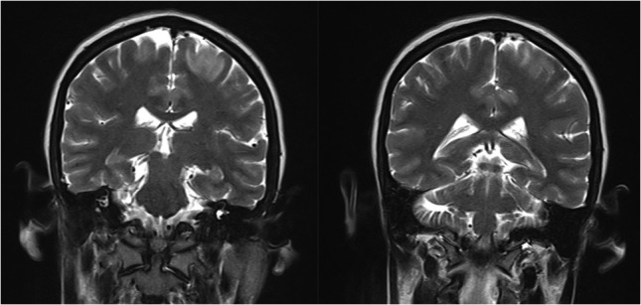

Slide 12

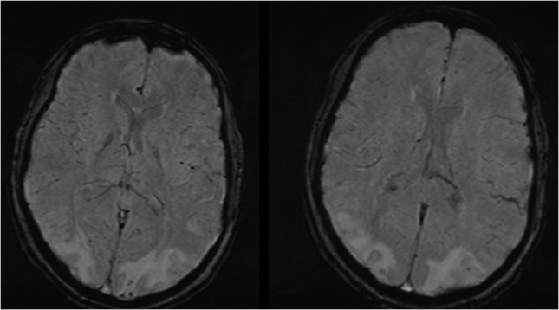

Slide 13
References
Alshami A, Al-Bayati A, Douedi.S* , Hossain MA, Patel S, and Asif A (2021) “Clinical characteristics and outcomes of patients admitted to hospitals for posterior reversible encephalopathy syndrome: a retrospective cohort study”, BMC Neurology. 21:107. Pp 1-7.
Gao B, Ly. C, Lerner A, McKinney AM (2018) “Controversy of posterior reversible encephalopathy syndrome: what have we learnt in the last 20 years?” J Neurol Neurosurg Psychiatry 89: Pp 14–20.
Gewirtz AN, Gao V, Parauda SC, Robbins MS (2021) “Posterior Reversible Encephalopathy Syndrome”, Current Pain and Headache Reports. 25:19. Pp
Liman TG, Siebert E, Endres M (2019) “Posterior reversible encephalopathy syndrome” Curr Opin Neurology 32(1). Pp 25-35.
Mergen S, Long B, and Matloc A (2021) “Posterior Reversible Encephalopathy Syndrome: A Narrative Review for Emergency Clinicians”, The Journal of Emergency Medicine. 61(6) Pp. 666–673.
Parasher A and Jhamb R (2020) “Posterior reversible encephalopathy syndrome (PRES): presentation, diagnosis and treatment”, Postgrad Med J . 96. Pp 623-628.
Shankar J, Jillian Banfield J (2017) “Posterior Reversible Encephalopathy Syndrome: A Review”, Canadian Association of Radiologists Journal. 68. Pp 147-153.
Staykov D, Schwab S (2011) “Posterior Reversible Encephalopathy Syndrome”, Journal of Intensive Care Medicine. 27(1). Pp 11-24.
Syuichi T , and Tomoko Ogawa T (2019) “Posterior reversible encephalopathy syndrome: A review with emphasis on neuroimaging characteristics”, Journal of the Neurological Sciences. 404. Pp 72-79.
Triplett JD, Kutlubaev.MA, Kermode AG , HardyT (2022) |”Posterior reversible encephalopathy syndrome (PRES): diagnosis and management”, Practical Neurology. 22. Pp 183–189.

